Slide 1
Customizing and Using SharePoint Sites
Module 5

Slide 2
Core Features of SharePoint
Everything is a list
Web Parts
Navigation
Branding basics
Advanced: Information Rights Management

Slide 3
Everything is a list
List are used to store information
Think of them kind of like a database table

Slide 4
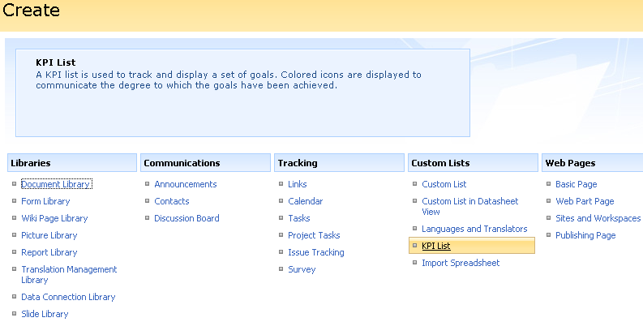
Types of list
Varies by site template and SP SKU

Slide 5
What makes list great
They are very easy to customize
Experience is always the same
Want more metadata?
Add a column
Views
Filtering, sorting, grouping, styling…
Security
Set at list or item level

Slide 6
Metadata vs. Folders
A fun debate
Folders
Traditional way of organizing content
Very easy for users
Metadata
New hip way to organize
Requires users to input data
Allows better search relevance
More flexible for creating views
SharePoint lists support both

Slide 7
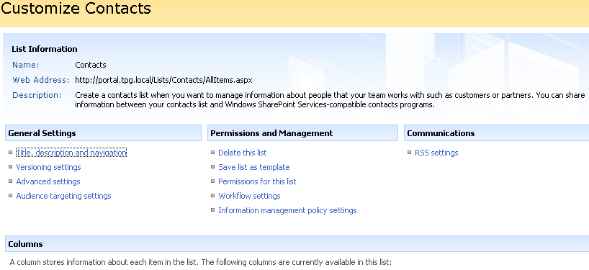
Demo!
Manipulate out of the box list
Folders & Metadata
Create a view
Create a custom list

Slide 8
Web Parts
The basis of building the user experience
Control that can be added to a page
2 “types” of Web Parts
List view Web Parts
Functional Web Parts

Slide 9
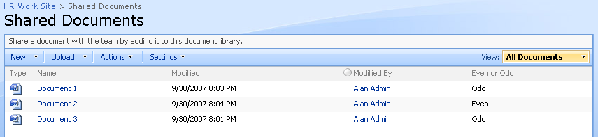
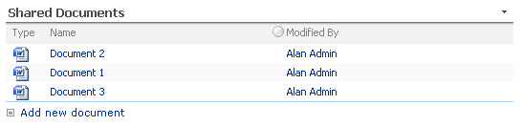
List View Web Parts
List view WPs display SharePoint Lists
Every time you create a new list you get a new Web part
List
Web Part

Slide 10
Functional Web Parts
They Do Work
Examples
Display data from a database, RSS feed, or user input
Transform the look of the page
Perform a search
Lots of 3rd party and free web parts available
Different SharePoint SKUs = different WPs

Slide 11
Demo!
List Web Parts
Functional Web Parts

Slide 12
Navigation
The key to finding things on the site
Very flexible
Targeting
Security trimming
Open in new window
Flyouts
Navigation Elements
Global Navigation
Current Navigation
Global Breadcrumb
Current Site Breadcrumb

Slide 13
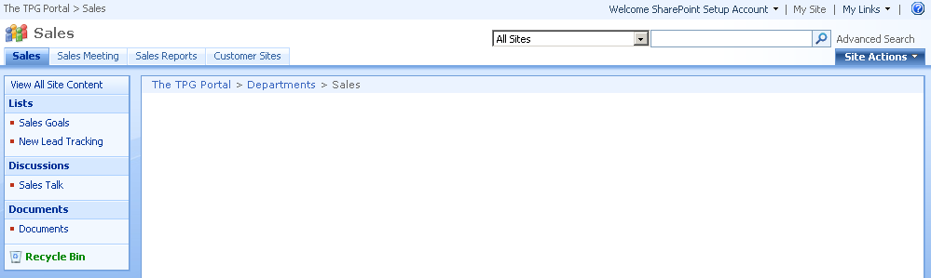
Picture worth 1000 words?
1-Global Bread Crumb 2-Global Navigation 3-Current Navigation 4-Current Breadcrumb

Slide 14
Global Navigation
Also called Horizontal Nav
Should make this as consistent as possible
Inherits from parent by default
Modify
Site Actions > Site Settings > Modify Navigation

Slide 15
Current Navigation
Called Quick Launch bar and Left hand Nav
Important since products can change the name
Provide links that are relevant to current site
Customizable same as Global
Can be disable thorough site admin

Slide 16
Breadcrumbs
Both self maintaining
Global is updated when you break global nav
Current just shows your path on the site

Slide 17
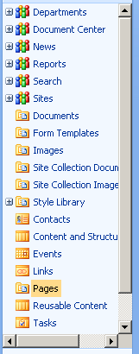
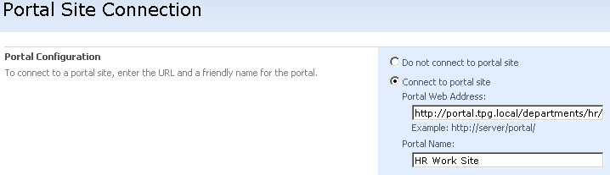
Other nav
Tree view
Looks cool
No settings
Portal site connection (up to portal)
Key for connecting separate Site Collections
Site Collection Administrator setting

Slide 18
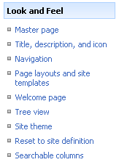
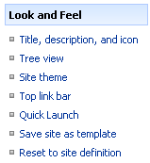
No Publishing Feature – Nav Changes
Instead of Site Settings > Navigation use
Site Settings > Top link bar
Site Settings > Quick Launch

Slide 19
Demo!
Walkthrough navigation

Slide 20
Change the look
Called branding
Themes
Master Pages

Slide 21
Themes
Change the colors and images used
Rely heavily on modifying CSS
Does effect all of the pages in a site
Relatively easy to develop your own

Slide 22
Demo!
Apply some beautiful out of the box themes!

Slide 23
Master Pages
Page made up of 2 parts
Master Page
Page layout
Actually can modify the structure of the page
Three types
Site
System
Application

Slide 24
Site Master
Site Master
Set at the site level
Affects web part pages
System Master
Set at the site level
Affects list view pages
Application Master
Set at the farm level
Affects files in /_layouts
Stored on file system, do not modify
Notes:
KB on modifying Application Master http://support.microsoft.com/kb/944105/en-us

Slide 25
Demo!
Change a site theme
Change the master pages for the site
Open a master page with SharePoint Designer

Slide 26
IRM
Information Rights Management
Relies on Rights Management Server (RMS)
Free add on to W2k3 Server
Works OOTB with Office 2003 and later
Free IE add-in available
Provides you with portable security
Integrates with SharePoint
Notes:
RMS http://www.microsoft.com/windowsserver2003/technologies/rightsmgmt/default.mspx
IRM in SharePoint Overview http://msdn2.microsoft.com/en-us/library/ms458245.aspx

Slide 27
IRM Rights
Full Control
Edit, Copy, and Save
Read
Print

